Slide 1
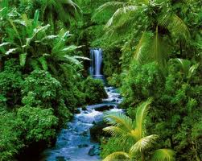
Rainforest

Slide 2
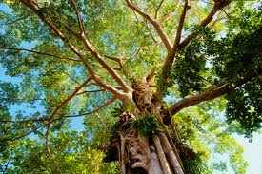
Rainforest is located near the equator .
In Rainforest is really hot and rains a lot .
Rainforest has four layers they are Forest Floor , Understory Layer , Canopy Layer and Emergent Layer .
The Rainforest is called LUNGS OF THE EARTH
because there is a greenhouse and it makes
oxygen .

Slide 3
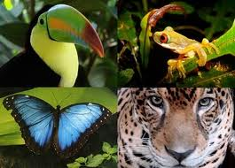
Rainforest Animals

Slide 4
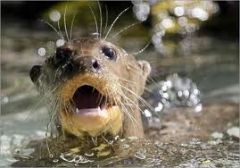
Giant Otter
They spend most of their time in the water and find most of their food there. Giant Otters hunt during the day and sleep at night. Their diet consists almost exclusively of fish, and is much less diverse then other otters. The outer fur is thick and waterproof. The inner coat includes an insulating layer of air, and stays dry even under water .

Slide 5
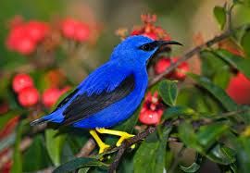
Purple Honeycreeper
There are many species of honeycreepers.
The Purple honeycreeper has a long bill which helps them catch insects and get nectar from flowers.
They are about 4 - 5 inches in length.
The males are a very colourful purple and the females are a dull green.
The female usually lays two eggs in a small nest on the end of a tree branch.
They are important in the rainforest food web because they help control the insect population.

Slide 6
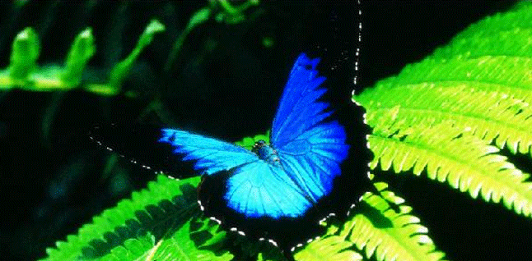
Butterflies
Blue morph's like other butterflies, also have two clubbed antennas, two fore wings and two hind wings, six legs and three body segments -- the head, thorax and abdomen.

Slide 7
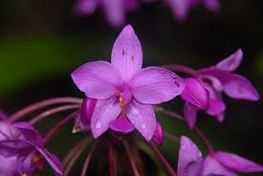
Rainforest’s plants and flowers

Slide 8
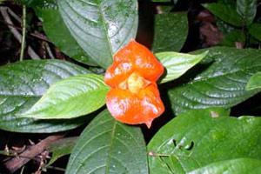
Hot Lips Flower
The beautiful flower on the right is a "Hot Lips" bush, a small shrub that lives under the rainforest canopy in the dark "understory." The bright red colour attracts birds to pollinate and disperse seeds.

Slide 9
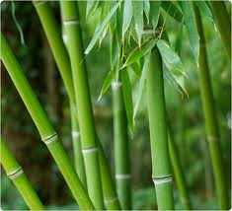
Bengal Bamboo
The Bamboos tilde can be found in the biome of the Southeast Asian rainforest. It often grows as an undergrowth scattered or in patches in the forest. It does very well in a moist environment with a lot of rainfall. It likes temperatures between 40 degrees Fahrenheit and 100 degrees Fahrenheit. Rainforests get around 100 inches of rain per year. Rainforests are found mainly around the equator. They hold many varieties of plants and animals.

Slide 10
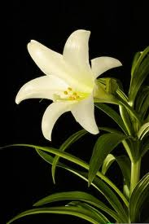
Lily
A
A sunburst of white petals, the Lily (Eucharis grand flora ) has a candy-sweet fragrance. Typically, three to six flowers cluster together, and the stems grow to an average of 12 inches. Akin to the daffodil, the Lily can be a garden flower in climates that receive equal amounts of sun and shade, and where the temperatures hover between 60- and 70-degrees Fahrenheit.

Slide 11
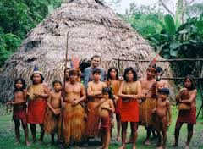
Rainforest Tribe
There are a lot of tribes that live in the Amazon rainforest. Many tribes have different cultures and traditions that are passed down for all Amazon tribes. For example: Yanomami tribes are the largest tribe in the Amazon today and they have different traditions from the Cabochons , Witoto , Manioc, and the Kayapo . Like the Yanomami is the Cabochons . The Cabochons live in the Amazon too. They are very skilled hunters. The Cabochons are very good cookers too. They are very wise and can live in the Amazon with out any problems. One tradition is that the Witoto tribe eats the meat of the people they kill and use their bones as souveniers or make things.

